Slide 1


Sap ABAP on Hana &
s/4hana trainings
Anubhav Oberoy

Slide 2

INTRODUCTION

Slide 3
Agenda – Day 1
Introduction to HANA
Introduction to IMCE( In-Memory Computing Engine )
Hardware and Software Innovation
Row v/s Column Store
Evolution of HANA with SAP solutions
Architecture of SAP HANA Platform
Describing Index Server
Describe How System Design Works
---Break---
Describing Job Roles
Tool’s :
Installation and Setup of ABAP Development Tool (ADT) on Eclipse.
Connection to your HANA Database System via HANA Studio.
Installation of Web IDE
How we use BAS ( Business Application Studio)
Describing Sever Option’s and Details
How ABAP Meets HANA Database
Understanding Concept of Schema

Slide 4
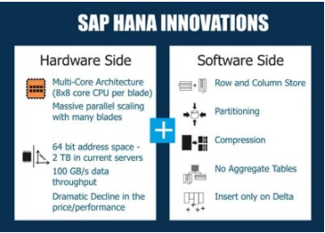
What is SAP HANA?
SAP HANA (high-performance analytic appliance) is an application that uses in-memory database technology that allows the processing of massive amounts of real-time data in a short time. The in-memory computing engine allows HANA to process data stored in RAM as opposed to reading it from a disk.
INNOVATIONS IN HANA
Several SAP HANA developers have made significant innovations in IT and in business models. Because of its in-memory approach, SAP HANA enables both hardware and software innovations which are unparalleled, replacing traditional databases in many spheres of business world! On the hardware side, SAP HANA facilitates Multi-Core Architecture (8×8 core CPU per blade), huge parallel scaling with several blades, 64 bit address space – 2 TB in current servers, data throughput as high as 100 GB/s, cost effectiveness and so on. On the software side, SAP HANA enables columnar data storage, partitioning, compression, eliminating aggregate tables, to name a few.
Software Innovation
Hardware Innovation

Slide 5
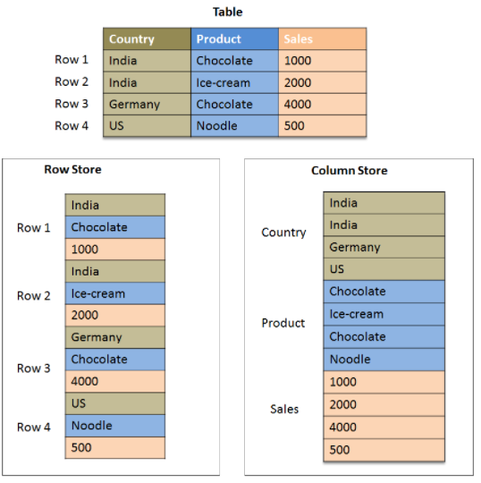
Row Store v/s Column Store
At a basic level, row stores are great for transaction processing. Column stores are great for highly analytical query models. Row stores have the ability to write data very quickly, whereas a column store is awesome at aggregating large volumes of data for a subset of columns.

Slide 6
Timestamp – Insert Only
Row Store
Column Store
If there is a need to read all the columns and all the rows every time. SELECT * unavoidable
If table gets changed so frequently and has low volume of data
Table has large no. of UNIQUE values
Typically guideline for row store is more strict.
Reads frequently and requires Agg. Then we should go columns provided not all columns required all times.
Data volume is too high and we have large no. of non-unique (repeating)
In any ERP system 70% read, 30%, Transaction and master table

Slide 7
Strategies with HANA
ECC
BW 7.31>
HANA driver
Other DB
HANA
Secondary
SAP HANA 1.0SP3
BW on HANA
Side-car Scenario
SAP NW7.4SP2
S/4HANA
ABAP
ABAP on HANA
Any DB / HANA DB
1.0 SP6
HANA DB
Suite on HANA
Notes:
The sole purpose of an R/3 system is to provide a suite of tightly integrated, large-scale business applications. R/3 comes prepackaged with the core business applications needed by most large corporations. These applications coexist in one homogenous environment. They are designed from the ground up to run using a single database and one (very large) set of tables.
Presentation: It is usually installed on a user's workstation. When started, the presentation server displays the R/3 menus within a window. This window is commonly known as the SAPGUI, or the user interface (or simply, the interface).
Basis : Basis is like an operating system for R/3. It sits between the ABAP/4 code and the computer's operating system. SAP likes to call it middleware because it sits in the middle, between ABAP/4 and the operating system. ABAP/4 cannot run directly on an operating system. It requires a set of programs (collectively called Basis) to load, interpret, and buffer its input and output. Basis provides the runtime environment for ABAP/4 programs.
Database: The database server is a set of executables that accept database requests from the application server. These requests are passed on to the RDBMS (Relation Database Management System). The RDBMS sends the data back to the database server, which then passes the information back to the application server. The application server in turn passes that information to your ABAP/4 program.

Slide 8
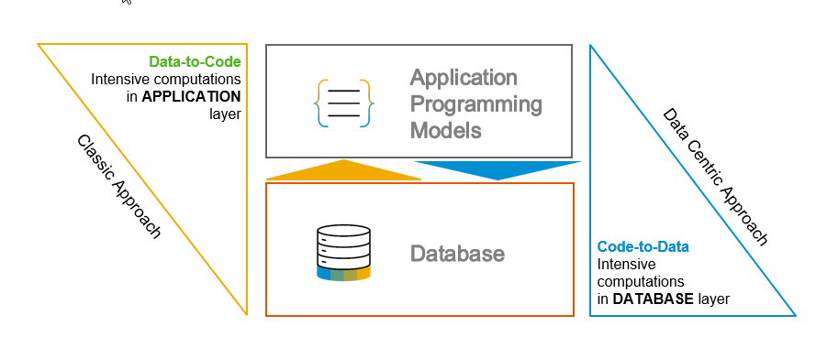
S/4 HANA, Suite on HANA and ABAP on HANA
Suite on HANA – Replace existing Any DB with HANA – SAP Product
S/4HANA – is also a product which is successor of Suite on HANA, Only runs on HANA – 2029 (all companies will be S/4)
ABAP on HANA – Technology on which these products are designed
Code push down
Code-to-data-paradigm
Most of the processing is pushed down to DB

Slide 9
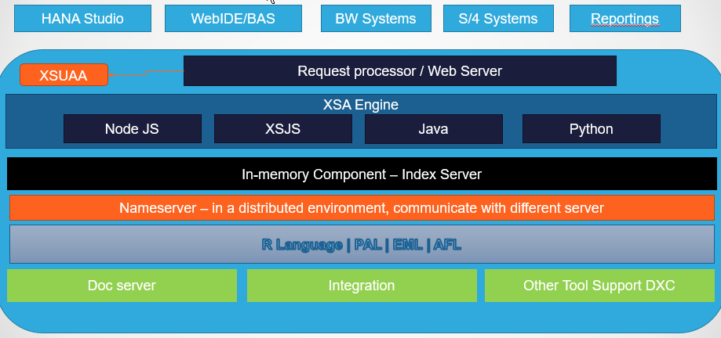
SAP HANA Architecture
SAP HANA System Architecture Overview. An SAP HANA system comprises multiple isolated databases and may consist of one host or a cluster of several hosts. An SAP HANA system is identified by a single system ID (SID) and contains one or more tenant databases and one system database.

Slide 10

Job Roles
ABAP on HANA Developer
After we move to HANA DB will my custom code work as before.
Once the move is complete, can we analyze programs which are taking more time then expected.
Can you optimize them as you mentioned HANA Is faster, parallel processing..
Leverage full power of code to data paradigm
If we tomorrow move to S/4HANA, will my code work?
Hey! I attended teched last year, they were yelling CDS view.
How can we leverage SAP’s ABAP stack to build HANA optimized apps
Can I use latest SAP Fiori UX to build ABAP app on S/4HANA
In past we had Bex, Info, DSO in BW with S/4HANA, I don’t have separate BW system, how can we do same on S/4HANA
HANA Administrator
Install HANA Box
Decide Which computer to install and how to connect to ERP
Manage HANA Users
Manage HANA Security
Create DB Backups
Monitoring System
System Security
DB Monitoring and Restore
HANA Consultants
Move data from one DB system to another DB system ETL
Data Modeling
Reporting on HANA using OLAP
HANA Developer (Native)
In your co. there is NO ABAP system just HANA Box
Native HANA Apps using HDI, Containers, Java, NodeJS, XSJS
XSODATA
HANA CDS .hdbcds, hdbdd, …

Slide 11

Break

Slide 12
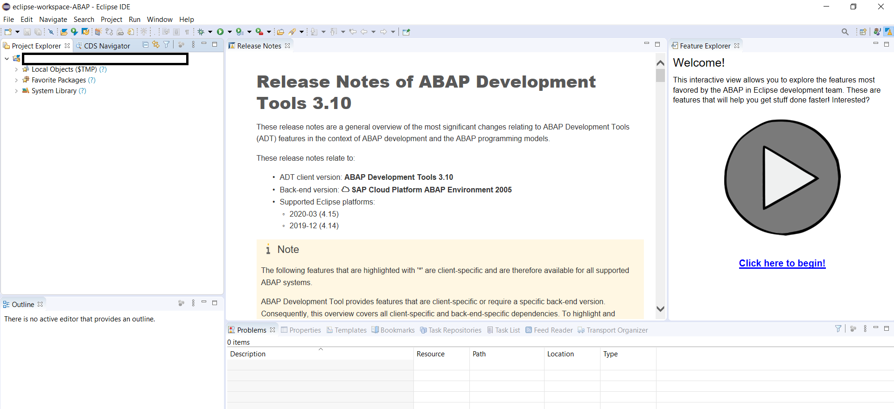
Installation & Setup of ADT on Eclipse
Go to below link
https://tools.hana.ondemand.com/#abap
Install Java = java –version to check if its already there
Java 8: SAP JVM 8
Java 11: SapMachine 11
VS Runtime - For Windows OS: Microsoft Visual C++ 2013 (x64)
4. Download and install eclipse
To install the front-end component of ADT, proceed as follows:
Get an installation of Eclipse 2020-09 (e.g. Eclipse IDE for Java Developers)
In Eclipse, choose in the menu bar Help > Install New Software...
Enter the URL https://tools.hana.ondemand.com/latest
Press Enter to display the available features.
Select ABAP Development Tools and choose Next.
On the next wizard page, you get an overview of the features to be installed. Choose Next.
Confirm the license agreements and choose Finish to start the installation.

Slide 13
Features of ADT ( ABAP Development Tool )
FREE and open source
Work with multiple systems parallelly
Fully customizable dev environment
It has integration with SAPGUI Ctrl+6
Fast Search and navigation
Ctrl+Shift+A – Search any object
Ctrl + T – Base classes
Integration with Transport Org, ATC
ABAP Profiles
This is the future of ABAP development on HANA and S/4HANA and even ABAP on Cloud
Verity of development using single tool – ABAP, UI5, HANA Navtive, Java, NodeJS, Android
Quick fix
Design time check on syntax
Code completion Ctrl+Space
Pretty Printer Ctrl+Shift+F
Code templates
Increases developer efficiency
ABAP has got new syntax, which means my old code is not dead and it will not work - False
True/False

Slide 14
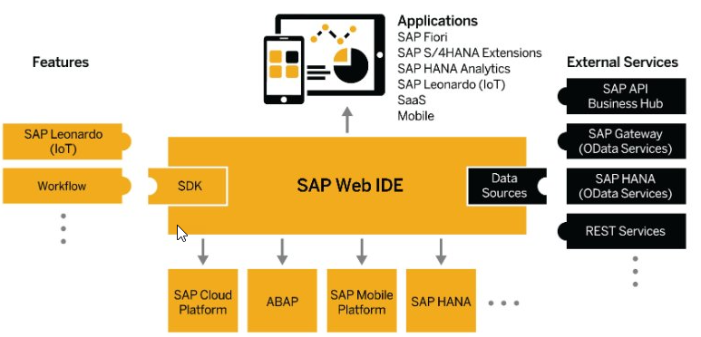
Installation of Web IDE
Prerequisites:
1. We must need jdk 1.8 in our system cmd-> java –version install jdk
2. Min 4 GB of RAM
3. Install WinRAR software in your machine
Steps:
1. Download SAP WebIDE PE
2. Copy the downloaded zip file and paste in c:\MyWebIDE
3. Right click on zip file and choose extract here, it will take upto 5 mins
4. You will see an folder called eclipse, go inside and you will see a file called orion.exe
5. Right click on orion exe and choose properties and select Run as Administrator checkbox
6. Apply and Ok
7. Optional – you can make a shortcut on desktop
8. Double click on orion exe file
9. Do not close command prompt window
10. http://localhost:8080/webide/index.html

Slide 15
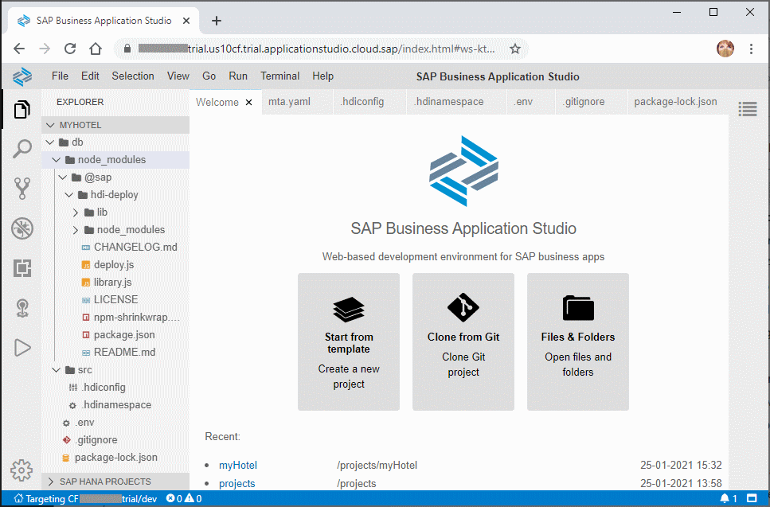
Business Application Studio ( BAS )
Steps :
Go to
https://cloudplatform.sap.com
2. Create free trial account
3. Launch your cloud platform trial cockpit - https://account.hanatrial.ondemand.com/cockpit
4. On main screen you will see BAS
5. Click and Create Dev Space
6. Choose SAP Fiori as dev space type

Slide 16
ABAP system meets HANA
Where do we develop programs in ABAP?
Inside packages. – They hold all the development objects
Delivery Unit (equivalent in ABAP) the content only we put in package
Group objects
Package provide a namespace to our HANA objects
Security – Who can develop inside a package

Slide 17
Schema
A Schema is a Runtime object, which is MANDATORY. It’s a compartment of all the other runtime objects e.g. Table, views, procedures, triggers, sequences, functions,….
It provides grouping of other objects
Controls security e.g. who can insert, update and delete data
In HANA whenever a user is created, a schema is created with the same name as the user name.
When an ABAP system talks to HANA, it will always and always and always and always read/write in one particular schema which is configured by BASIS at the time of Installation. When I create a Table in SE11 in ABAP, that table will get stored on activate button inside one schema only.

Slide 18
Feedback
AnubhavTrainings.com :
https://www.anubhavtrainings.com

Slide 19
End of Day 1

Slide 20

Questions

Slide 21

Anubhav Oberoy

